Slide 1
Blood Findr
Lord Caguiat
Enrico Gloria
Vince Nato
Sean Magalong

Slide 2
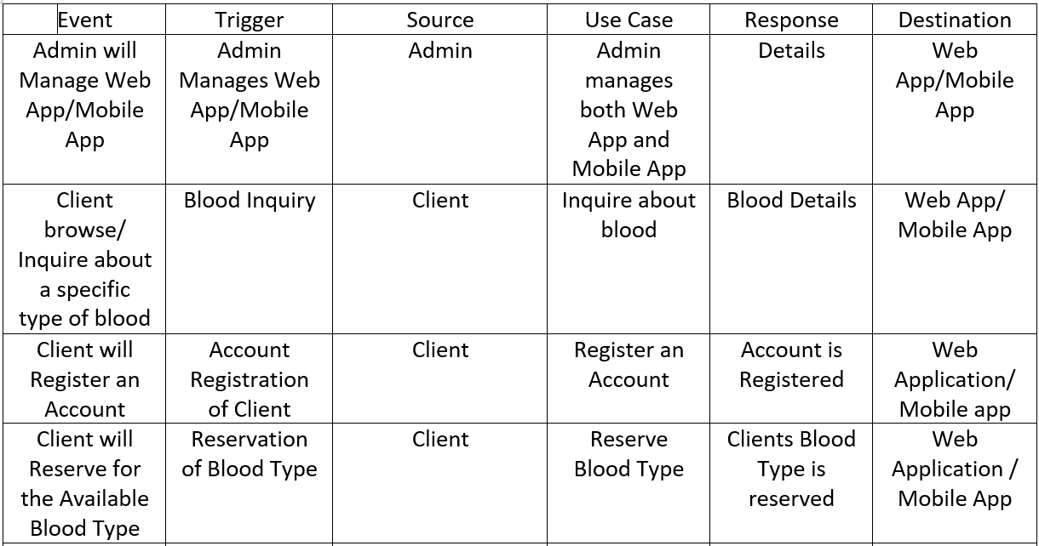
Event Table:

Slide 3
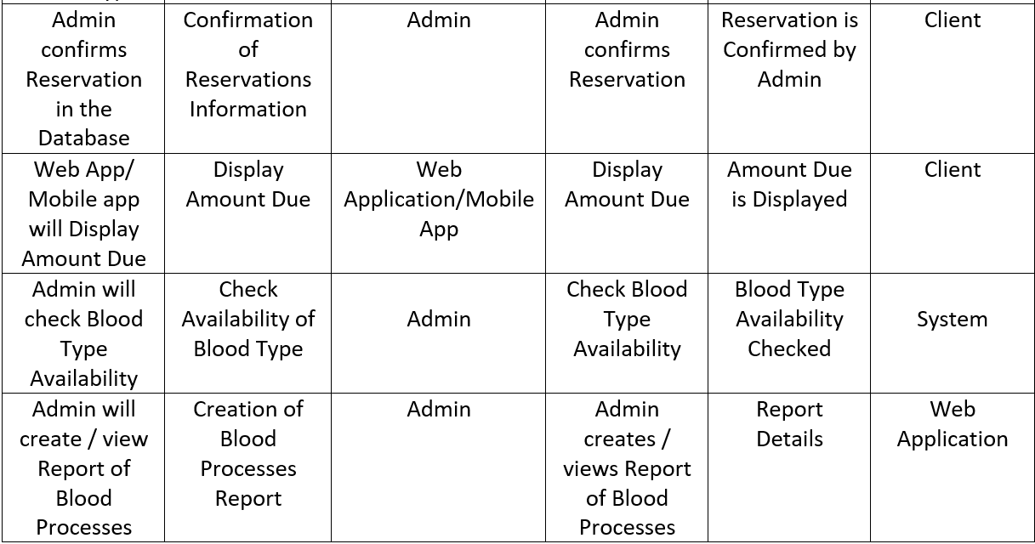
Event Table (cont.):

Slide 4
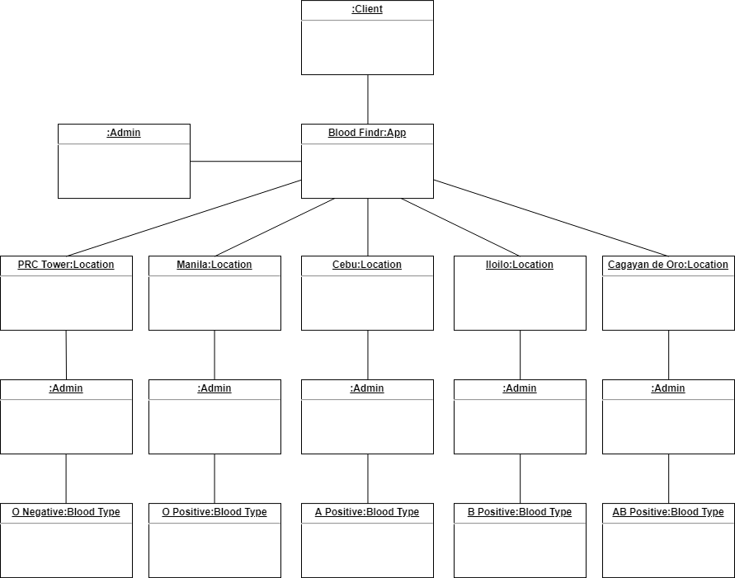
Object Diagram:

Slide 5
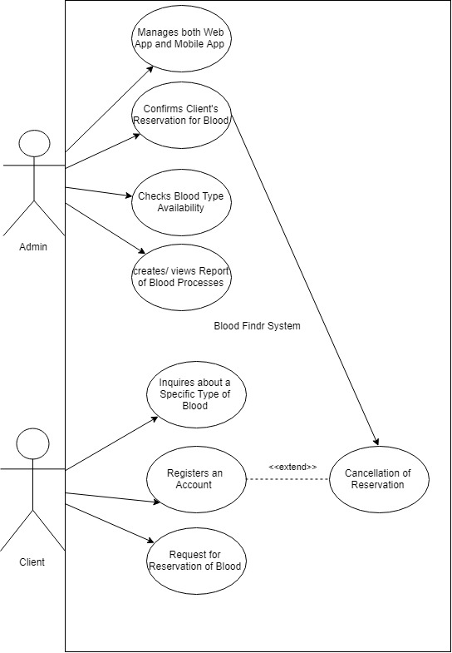
Use Case Diagram:

Slide 6
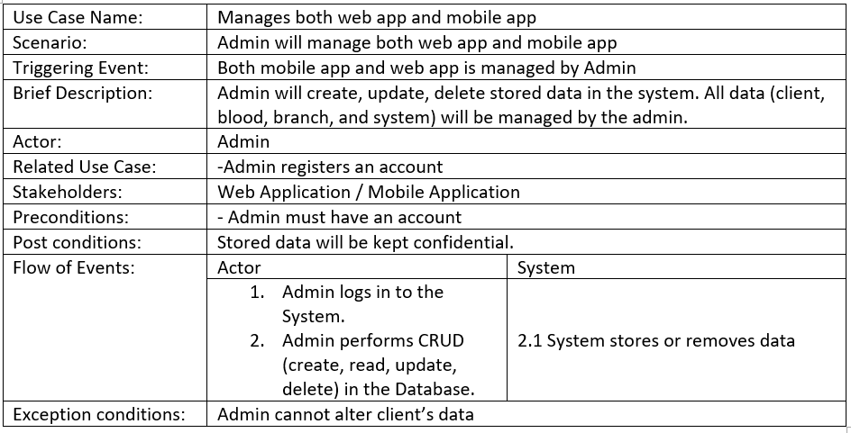
Use Case Full Description:

Slide 7
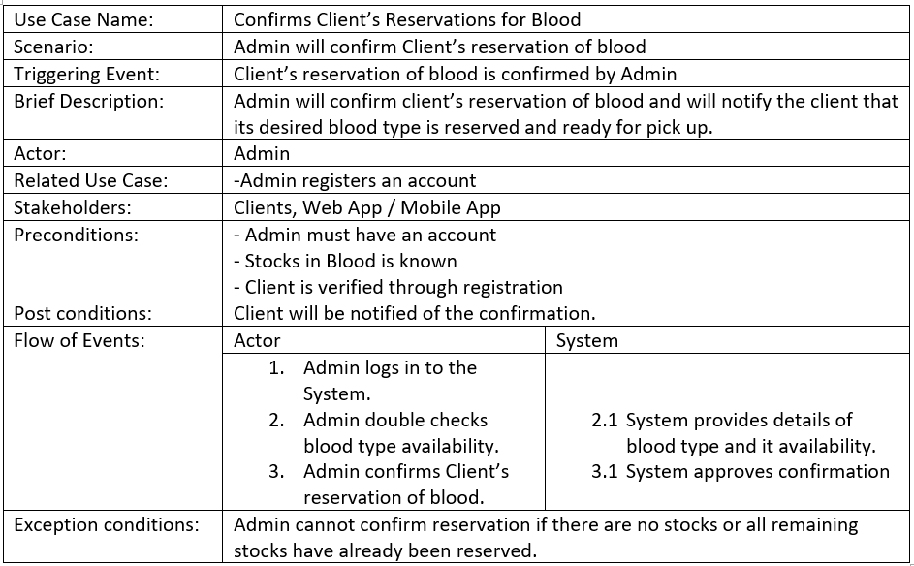
Use Case Full Description (cont.):

Slide 8
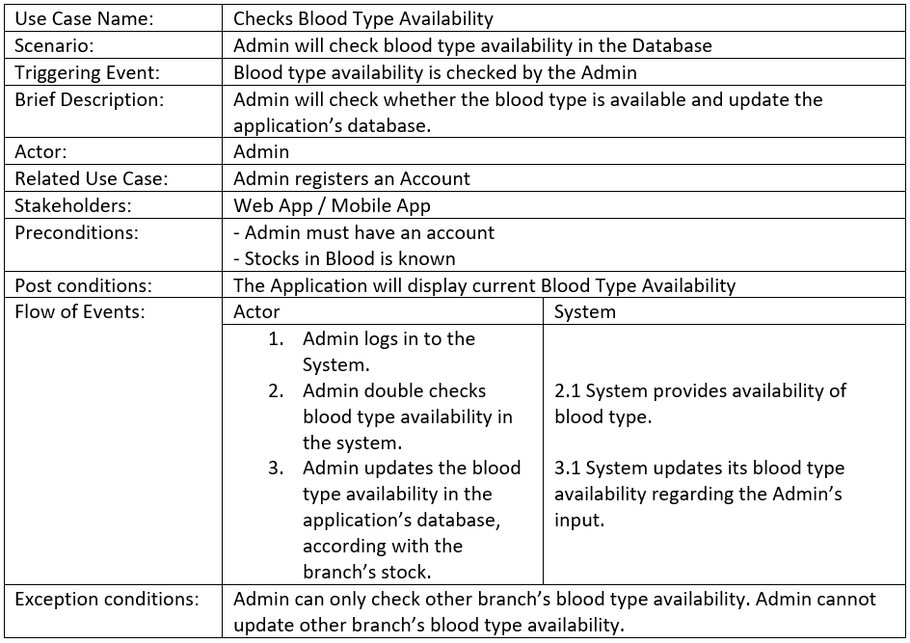
Use Case Full Description (cont.):

Slide 9
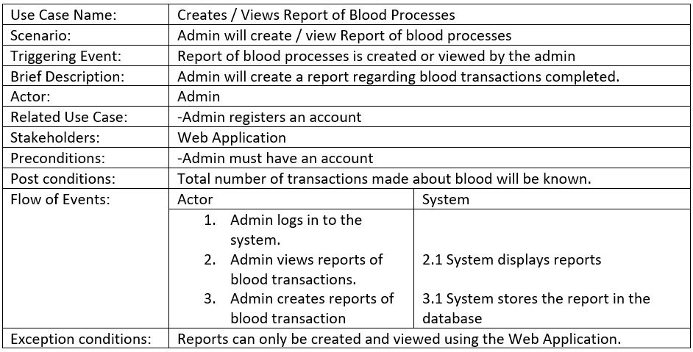
Use Case Full Description (cont.):

Slide 10
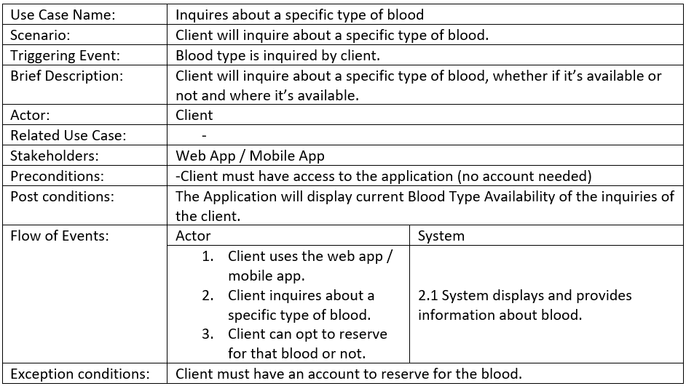
Use Case Full Description (cont.):

Slide 11
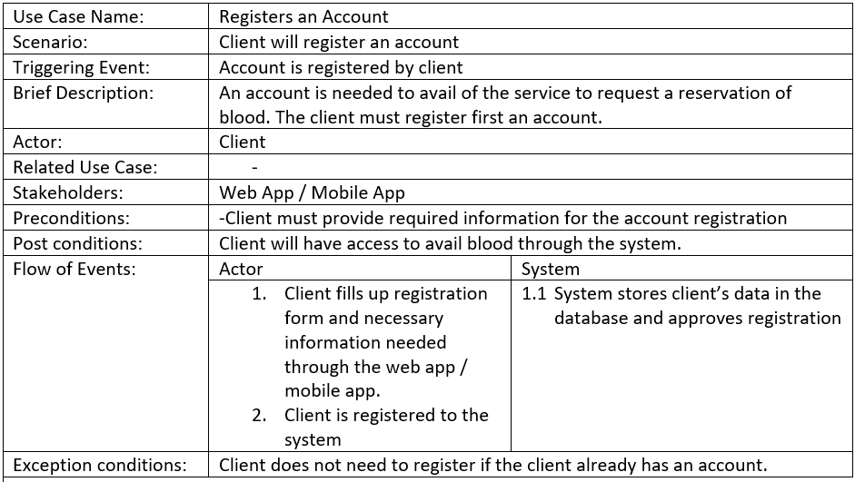
Use Case Full Description (cont.):

Slide 12
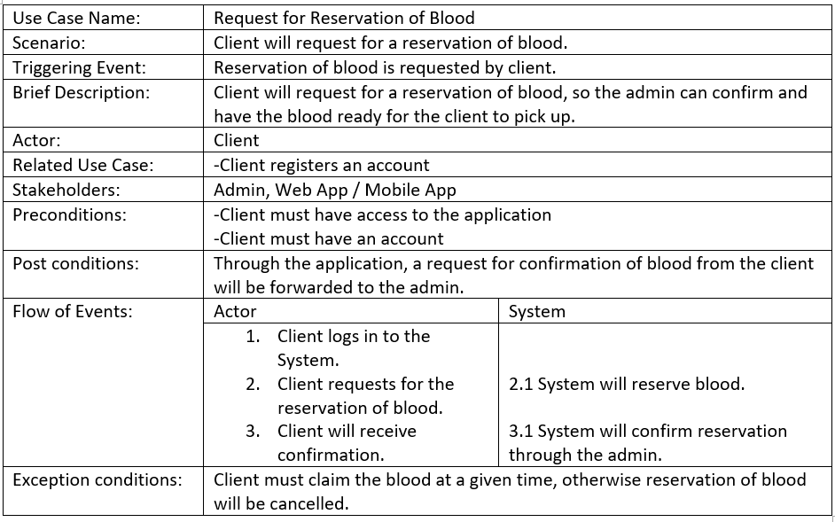
Use Case Full Description (cont.):

Slide 13
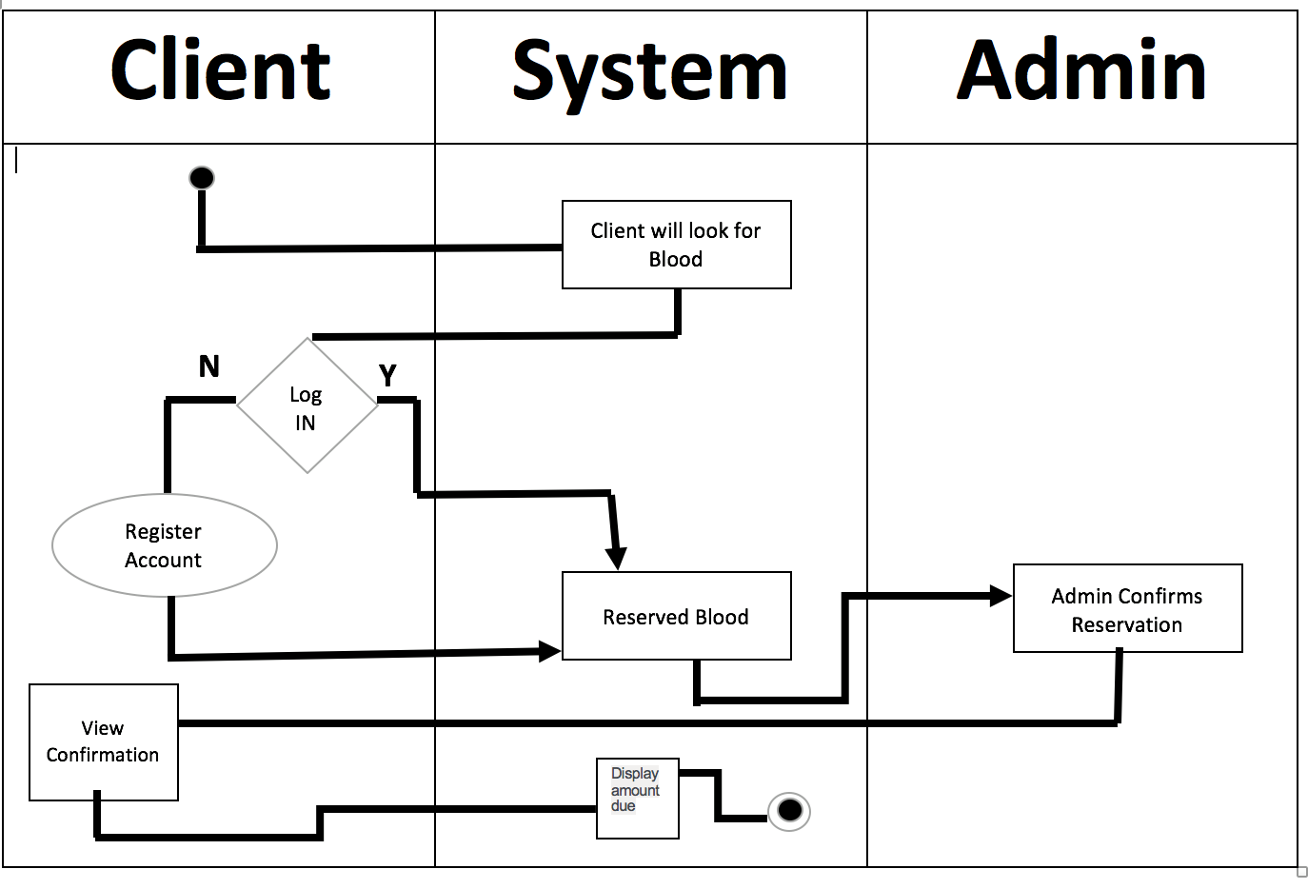
Activity Diagram:

Slide 14
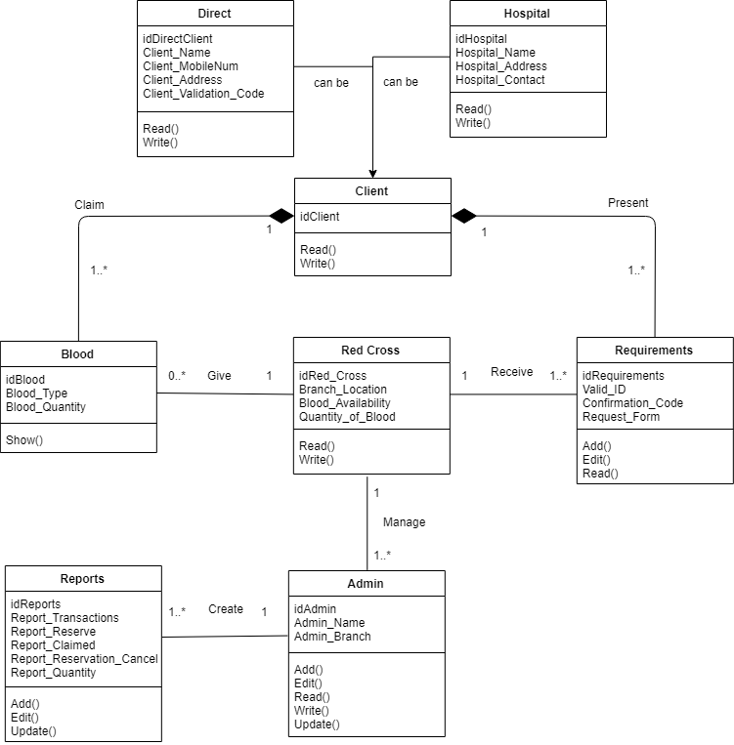
Class Diagram:

Slide 15
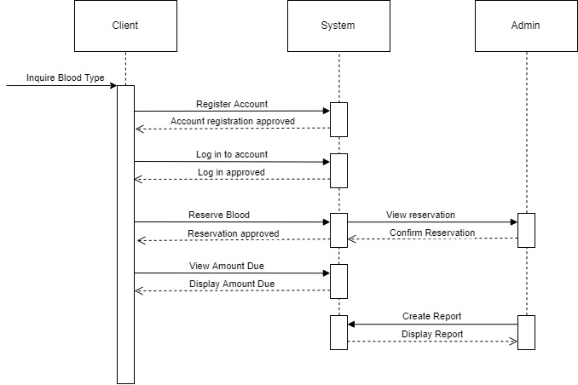
Sequence Diagram:

Slide 16
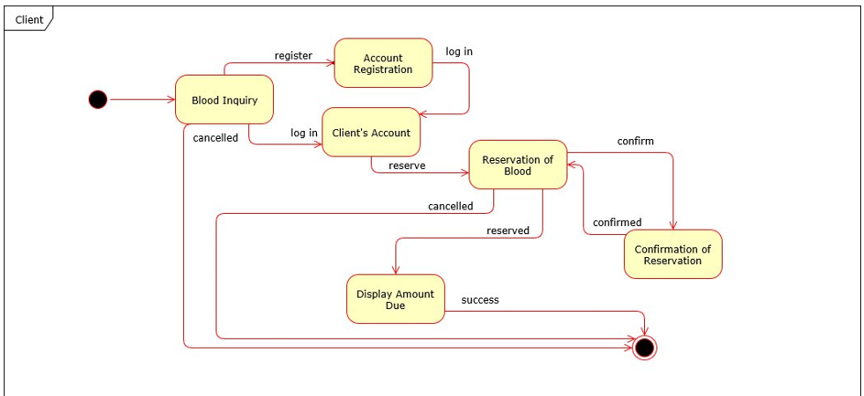
State Machine Diagram (Client):

Slide 17
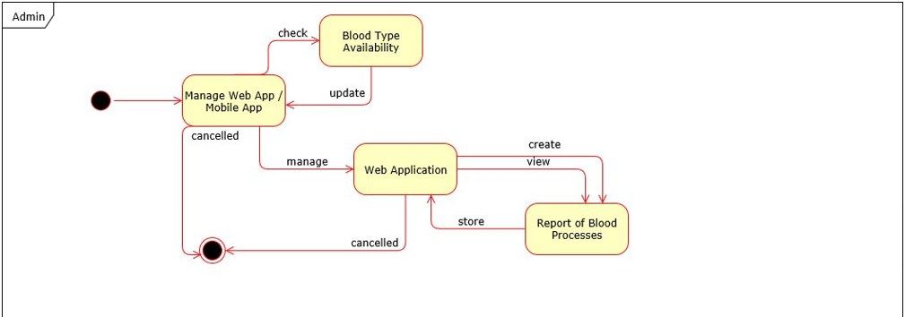
State Machine Diagram (Admin):

